Slide 1
Learning & Development UPDATES
21 July 2023
Notes:
Welcome! My name is Kimberly Kouame and I work on the Learning and Development Team. I’m the Learning Resources Manager and my team oversees the Learning Center, creating content for role-based training, and leader’s guides for learning events like PETS.

Slide 2
AGENDA
PETS CURRICULUM
Data
Staying Connected
Notes:
Today I’m going to cover three topics.

Slide 3
PETS Curriculum
Notes:
How many of you have heard about our organizational culture shift from training to learning? Maybe you’ve seen the new titles of a select group of roles, etc. Great, I’d like to provide more background and information to you so it can help inform the way you deliver content.

Slide 4
Notes:
I’d like to start by talking about our philosophy. In Rotary, we want learning to be fun and engaging and participant centered. Running a club should not feel overwhelming, many times incoming presidents can pull from past work experiences or past experiences within their club and apply them to this role. Facilitated sessions will help bring out those experiences into the room and you’ll have more ideas shared.
How many of your PETS last year had facilitated discussions during breakout sessions? How many plan to have them next year? How many had your facilitators do practice sessions in front of other facilitators and get feedback on what went well and what needs to be approved.
This culture shift is hopefully creating a more participant-centered experience. Another way to ensure you are considering your participants is to survey and evaluate their learning.
Show of hands and keep them up for a minute so others can look around and see who is doing this and follow-up with you after the session. How many of you ask participants to evaluate your in-person PETS at the end of the event? How many evaluate how PETS and pre-PETS prepared them for their role during their year in office? How many of you survey participants before PETS to see how many have been in this role before, how long they’ve been in Rotary, the biggest questions they have or ask them what they feel they need to learn?
Those are some things to consider as you get into planning. The main take away is to try not to talk at them for an entire session. Pose questions, break them into small groups to discuss a topic, or solve a problem.

Slide 5
Notes:
As you can see here, it’s not just about attending PETS or only taking courses online, there are a lot of things people can be doing to prepare, multiple ways to learn.
HOW MANY HAVE HEARD PETS IS A FIREHOSE OF INFORMATION?
Has anyone had success in trying to change this?
These steps don’t need to be done in order, as you can see the boxes overlap to show that they all work together. These can be found in the Get Ready course for club president, club secretary, club treasurer, district governor, assistant governor, and district Rotary Foundation committee chair and can be downloaded from the Learning Center to share.
The Board of Directors is requiring that club presidents, secretaries, and treasurers complete their role-specific learning plans in the Learning Center before taking office beginning this coming July 1 2024. What does this mean? It means we at least want every club president to log into the learning center, check out the resources available to them, and complete the ones that they feel they need.
Currently most club presidents don’t even know these courses are available. We want to make sure they know where they are and they can demonstrate this by enrolling in the Club President Basics and Club President Intermediate learning plans. We aren’t policing that they finish every course, but we would like to see more club presidents becoming aware of where their resources are.

Slide 6
Build Curriculum from Online courses
Leader’s guides being revised to build off courses
Online content is for self-paced learning
In-person learning is best for sharing ideas in small groups, action planning, regionalized content, and finding solutions to our challenges.
Notes:
Here’s how we are supporting that. We are building leader’s guides with the assumption that members took the online courses.
Online courses are best for self-paced learning on basic information while in-person learning is best for idea sharing in small groups and regionalized content.
So it doesn’t mean, present the course content at your PETS. That would be redundant for those that completed the courses.
If members didn’t take the courses prior to the event, maybe they didn’t feel like they needed them, or maybe they plan to take them later when they have more time. If you replicate what’s in the courses, it’s repetitive and boring for participants.
An example would be, as curriculum leads, take the course on the essentials of understanding conflict. If you want to have a breakout session on this topic because you think it’s important, don’t provide the same information again, ask the participants to get into small groups, share a conflict and how they’ve dealt with it, if it was successful or unsuccessful. If unsuccessful, how would others have handled it. This way they learn from each other and can try new ideas when they get back to their club.
Same with The Rotary Foundation. If they take the course prior to PETS, they will be prepared to discuss activating The Foundation in their club. If they are confused about what a specific program or fund is, have someone in the room explain it to them. Keep the focus on how to implement the programs of the Foundation in their clubs so they leave with actionable items.

Slide 7
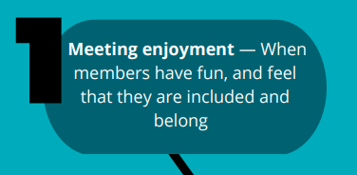
Club Experience Matters Most

Slide 8
PETS Leader’s Guide - Curriculum
Planning the Year Ahead
Conducting Meetings
Preparing to Lead
Engaging Club Members
Attracting New Members
Managing Your Club
Notes:
These are the main sessions that should be included in your PETS> This is very heavy on the business of your club and less focused on details like club logo and fundraising.

Slide 9
PETS Leader’s Guide – Optional Curriculum
Fundraising for The Rotary Foundation
Rotary Programs for Young Leaders
Service and Your Community
Telling Your Rotary or Rotaract Story
Using Social Media
Your Public Image Campaign
Notes:
Remember all club officers should be attending DTA including presidents, so they may be getting some of this during that meeting. Hopefully the PETS organizers are coordinating with DGEs so DGEs can build off this event and prepare DTA.

Slide 10
Notes:
We've started to change our language on the Learning Center from training to learning as part of our culture shift. This is a work in progress. This year we are updating a lot of courses. There will be a lot less new courses available over the next 18 months because we want to make sure what we have is up to date. As things will change after Council in April.
Event titles that require changes through the Council on Legislation (COL), such as the Presidents-elect Training Seminar, have not been updated yet. Rotary’s Learning Committee will continue to consider what is needed to fully move us from training to learning and will make recommendations to the RI Board. This will include additional code edits and board decisions to change other roles that don’t need COL approval, such as the GETS Team Lead and the IA Seminar Trainer. We’ll be working on this for the next few years with the Learning Committee, the Board, and the COL.
You are encouraged to consider how this shift from training to learning impacts your activities and to start changing where needed.

Slide 11
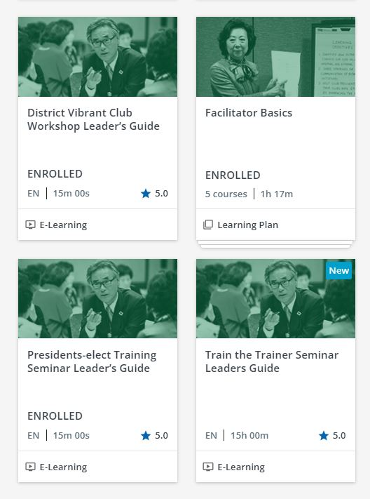
Notes:
The last catalog I wanted to point our was our Trainer catalog. This has basic information on how to facilitate in-person or online sessions. We recommend that anyone conducting training at the club, district, or zone level should complete the Facilitator Basics learning plan prior to the event. We also recommend hosting in-person practice sessions for your facilitators to practice their session and receive feedback from their peers, like what IA Learning Facilitators do to prepare for the International Assembly the week before governors-elect arrive.
Several of our Leader’s Guides are in here including the PETS LG and District Training Assembly LG which is newly revised this year.

Slide 12
Club President Basics
Courses 2024-25
Getting Started with the Learning Center
Get Ready: Club President
Managing Club Business
Working with Your Club Leadership Team
Minimizing Risk
Rotary’s Action Plan and You
Best Practices for Engaging Members
Rotary Club Central Resources
Online Membership Leads
Notes:
These slides show the current learning plans for this Rotary year.
Ideally your PEs are taking this set of courses prior to PETS.

Slide 13
Club President Intermediate
Courses new
Is Your Club Healthy?
Be a Vibrant Club
Creating an Inclusive Club Culture
Promoting your Club as People of Action
Committing to Diversity, Equity, and Inclusion
Preventing and Addressing Harassment
Protecting Personal Data
Leading Change
Protecting Youth Program Participants 2024-25
Rotary Foundation Basics
Notes:
One difference you will notice is Protecting Youth Program Participants is now an annual course. Members working with youth should take this course annually. It will work similarly to grant management recertification; except we give you the entire course each year. This year the content didn’t change from last year, but we hope to start on revisions to have them ready for next year.

Slide 14
Data
Notes:
SPEAK SLOWLY KIM - Let’s look at data specific to Presidents and then we’ll get into some Learning Center data.

Slide 15
Leadership Survey 2023 – The most valuable resources to prepare
Notes:
Globally and regionally, this is an increase of 5% of club presidents finding PETS the most valuable. Online courses increased by 1% but we’ll see if that shifts in the next survey due to the courses now being required.
Learning from their predecessor went down by 1% and other increased by 2%.
Does this data say anything to you? What do you think when less than 50% say PETS is useful? Do you get more than 50% of PEs to attend?

Slide 16
How prepared Were presidents for their role 2022 vs 2023
Notes:
You can see in blue the numbers for 2022. In 2023, you see globally in purple but then the yellow represents that 2023 data only for the US/Canada/Caribbean meaning in this region they feel very prepared more often than in other areas, and I believe that’s thanks to this group and all the work you do all year long.
How many thing some of this is out of your control?
What are some of the problems you are running into?

Slide 17
2023-24 Club President Course Progress
Notes:
This data was collected as of September 2023

Slide 18
2024-25 Club President Course Progress
Notes:
Data collected as of 16 July 2024.

Slide 19
2024-25 Rotary Club Presidents As of 16 July 2024
36,567 possible club presidents, 22% completed their learning plan at 100%.
26,656 of reported presidents have a My Rotary Account, 30% completed their basic learning plan.
32,897 reported to Rotary as of 16 July, of that, 24% completed their basic learning plan.

Slide 20
Course Completions by Zone
Notes:
As of 1 July 2024
The average per zone is 30,400 courses complete.

Slide 21
Course Completions by Zone
Notes:
As of 1 July 2022
If we look a little more closely at the US zones, we can see they aren’t meeting the average. There is lots of room for growth.

Slide 22
Percentage of Clubs using the learning center
2020-21
2021-22
2022-23
2023-24
43%
51%
51%
47%
57%
49%
49%
53%
18,325 clubs
22,766 clubs
23,426 clubs
23,454 clubs
Notes:
For 2023-24 based on June 20, 2024 club numbers. Updated 30 June 2024.
Note the first year does not include Rotaract clubs.

Slide 23
Stay connected
Notes:
SPEAK SLOWLY MEGAN – Now that you’ve learned about all the content available and how to access the content, let’s look at how to stay connected to what’s new.

Slide 24
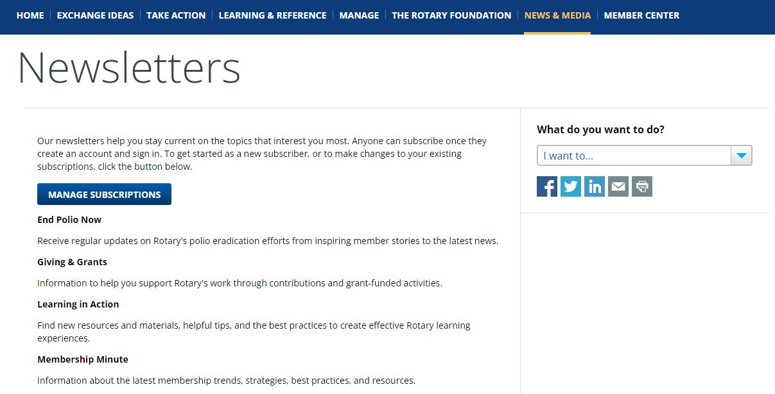
STAY CONNECTED: Learning IN Action
Notes:
If you would like to receive communications from us about new courses or other information related to the Learning Center and more, you can go to My.Rotary > News & Media > Newsletters and manage your subscriptions. Be sure to select “Learning in Action” for updates.
Note that we are in the process of updating this page to reflect the new newsletter title to Learning in Action.

Slide 25
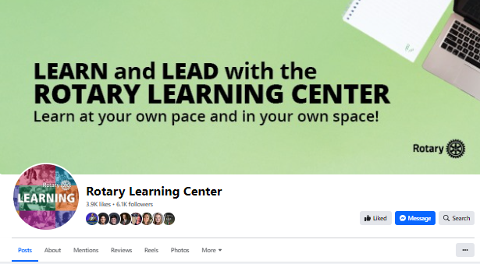
STAY CONNECTED: facebook
Notes:
The Learning Center also has a Facebook page! Visit our page for new and revised course promotions, data, and tips. In addition, please share the page and any tips posted to your Facebook feed. This helps us spread the word to Rotarians about this great learning tool.
Use the posts we create, take only the EN image, and reshare it on your page.

Slide 26
Thank you!
learn@rotary.org

Slide 27
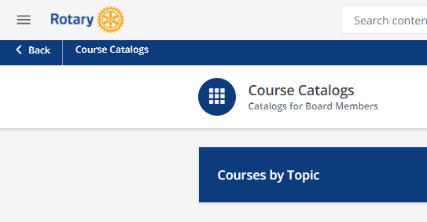
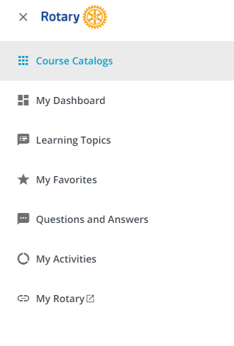
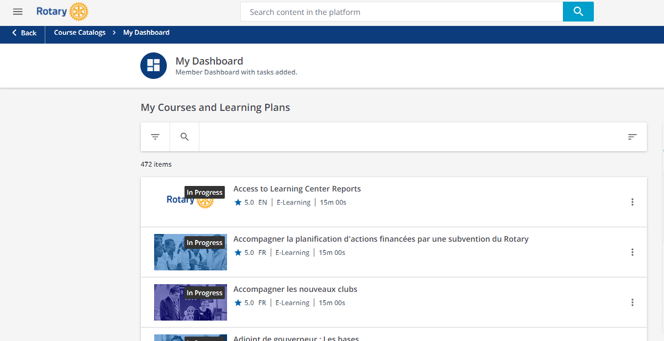
Get Access to Reports
1
2
3
Notes:
First, if you don’t currently receive reports, and you are a DG, DGE, DGN, DT, DMC, or DRFC, you can complete the Access to LC reports and complete the course. Here are the steps:
Click the three lines at the top to access the menu
Choose My Dashboard
Click the Access to Learning Center Reports course. If it doesn’t appear on the top you can filter in the top right corner A-Z.
Complete the course and you should have access to reports the following Monday.
These members can share reports with other district committees, Ags or clubs if they are interested. The district leaders can decide if someone else needs to manage the reports and they can share them.

